Slide 1
The Signal in the Noise with Machine Learning Algorithms and Spine Classification
Michael Streyle
11/29/18

Slide 2

Goals of the project
Compare performance of models
Logistic Regression
Support Vector Machines
Random Forests
Learn and use a new model
GUIDE
The Signal in the Noise – Nate Silver
Notes:
- First 3 models are very powerful and popular models that are covered in DS420 and Math327
- GUIDE is “Generalized, Unbiased, Interaction Detection and Estimation” (GUIDE), developed by Wei-Yin Loh at the University of Wisconsin, Madison.
- Nate Silver – statistician who works in baseball and election analytics. Founder of website FiveThirtyEight

Slide 3
Why is this important?
Many Machine Learning applications have hundreds of variables but only a few of significance
Genomics
Recommendation Algorithms
Natural Language Processing
Keeping track of the signal in excess noise is increasingly important in the world of Big Data

Slide 4
The Data
Publicly available on Kaggle
12 spinal measurements – centered around 0 with scale() function
1 classification – Normal and Abnormal
310 observations
Goal of modeling is to classify a spine as Abnormal/Normal based on the 12 spinal measurements, which are all continuous

Slide 5
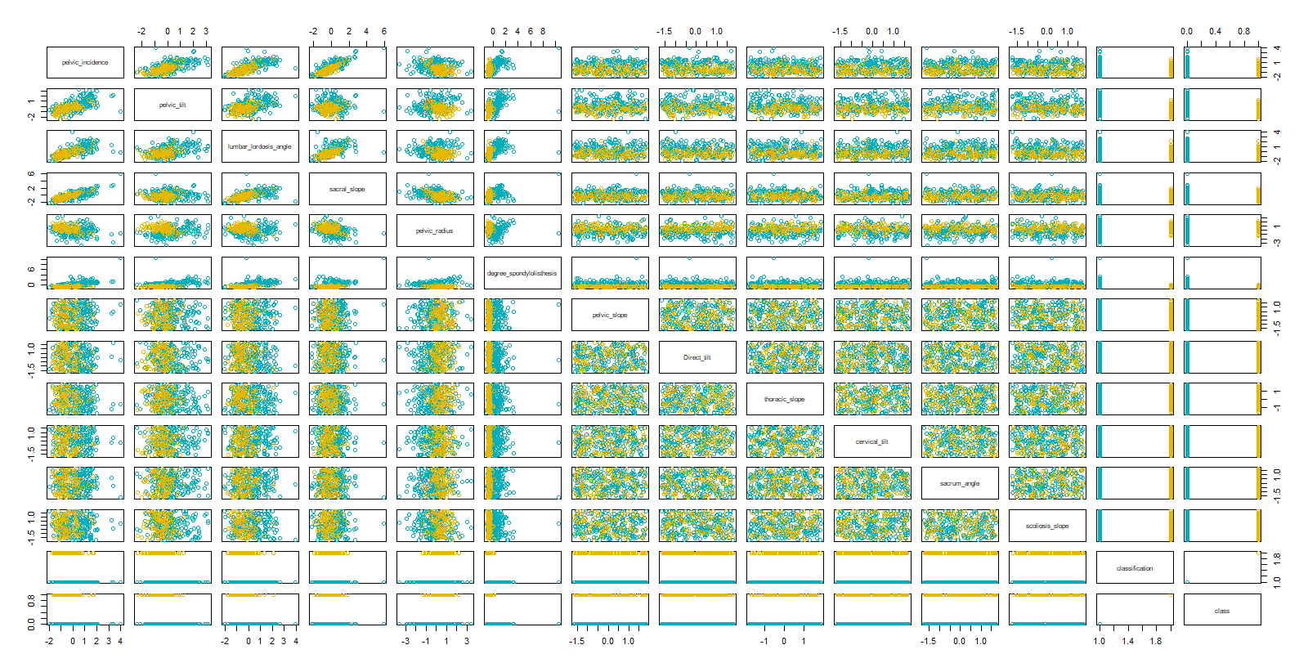
The Data
Notes:
First 6 variables are the only real variables in the dataset
Last 6 are random noise, no patterns or correlations
Last two are Classification, one is strings, one is numeric
All variables are normal and symmetric except degree_spondylolisthesis – right skewed

Slide 6

Definitions
True Positives = Predicted Abnormal when observation is Abnormal
False Positives = Predicted Abnormal when observation is Normal
True Negatives = Predicted Normal when observation is Normal
False Negatives = Predicted Normal when observation is Abnormal
Accuracy =$\frac{\text{TP}\text{ + }\text{TN} }{\text{TP}\text{ +}\text{FP}\text{ + }\text{TN}\text{ +}\text{FN}}$

Slide 7
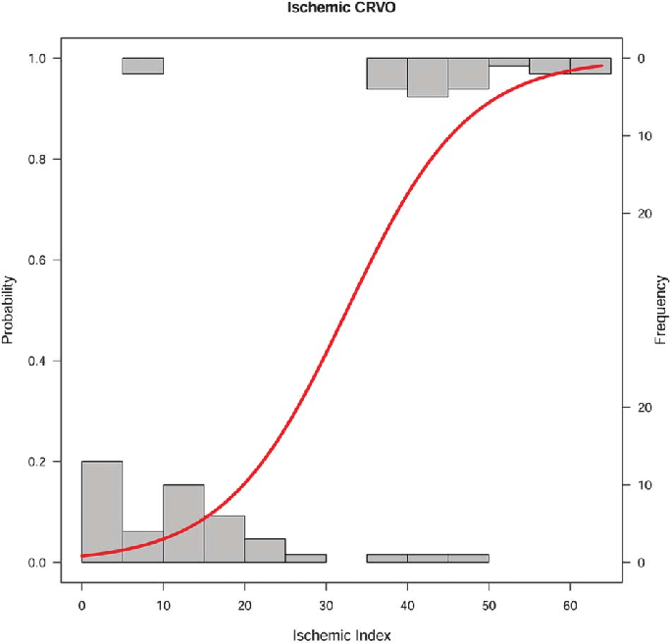
Logistic Regression – what is it?
1
Logistic regression models the probability of a yes/no outcome
Predictions are between 0 and 1
Prediction of yes/no outcome is made from a probability cutoff
0

Slide 8
Methodology
Train/Test Method
Randomly split the data into 80% and 20%
Fit (train) the model with 80% of the data
Evaluate the model with 20% of the data
Forward Stepwise Variable Selection
Begin with intercept only model
Incrementally adds variables
Only keeps variables that significantly improve model

Slide 9
Initial Logistic Regression Model
Train/Test method using all the predictors
Accuracy of 0.8387
36 true positives, 6 false positives, 16 true negatives, and 4 false negatives
Train/Test method using Forward Stepwise Variable Selection
Accuracy of 0.8548
37 true positives, 6 false positives, 16 true negatives, and 3 false negatives
Variables included: degree_spondylolisthesis (2.98e-11), sacral_slope (1.15e-05), pelvic_radius (0.00012), pelvic_tilt (0.01426), and Direct_tilt (0.09473)
Notes:
Interaction effects were included in another model, but were insignificant and performance worsened. Interactions were then removed.
Train/Test method: train on 80% of observations and test on 20% of observations. Weak because only making predictions on 1/5 of the data
Forward stepwise variable selection. Begins with intercept only model, and incrementally adds variables. Only keeps variables that significantly improve model

Slide 10
Methodology
Cross-Validation
Split data into n folds/groups
Use one fold as test data, and fit the model on the remaining folds
Repeat
Optimization Method
Use fitted values in training data as possible cutoffs in grid search
For each iteration, the fitted value with highest accuracy score is used as the cutoff
Each fold of cross-validation has a different cutoff

Slide 11
Initial Logistic Regression Model
With Cross-Validation and Optimization:
Accuracy of 0.8581
189 true positives, 23 false positives, 77 true negatives, 21 false negatives
Marginally better performance, but much more conclusive and less prone to overfitting
Notes:
Cross-Validation: data is split into n fold, or subgroups. Then the model is trained n times, each time leaving out one of the subgroups and using it as a test set. The result is predictions for every row in the data, yet still using separate data to train each model than what is used to test the model
Optimization Method: for each fold of the cross-validation, the fitted values for the training set are used as possible cutoff values for the test set, and grid search is used to find the optimal cutoff for that fold. That cutoff is then used for the predictions for the fold that was left out.
- Each fold has a different, but optimized cutoff.

Slide 12
Logistic Regression with PRV and +10
Remainder of Logistic Regression models use forward stepwise variable selection, cross-validation, and cutoff optimization
With Provided Random Predictor Variables:
Accuracy of 0.8548
193 true positives, 28 false positives, 72 true negatives, 17 false negatives
With 10 added Random Predictor Variables
Accuracy of 0.8419
187 true positives, 26 false positives, 74 true negatives, 23 false negatives

Slide 13
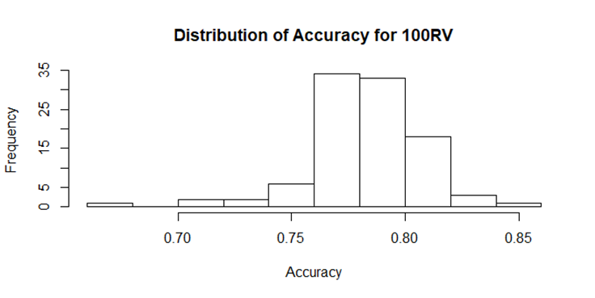
Logistic Regression with100 RV
100 Random Predictor Variables:
Accuracy of 0.7774
175 true positives, 34 false positives, 66 true negatives, 35 false negatives
Simulation Variability - distribution of 100 retrained models
Notes:
The histogram gives insight into the distribution of the accuracy of this model, and confirms that the model would continue to perform with an accuracy score between 0.75 and 0.82.

Slide 14
Logistic Regression with 500 & 1000 RV
500 Random Predictor Variables:
Accuracy of 0.80
175 true positives, 27 false positives, 73 true negatives, 35 false negatives
1000 Random Predictor Variables:
Accuracy of 0.6774 → converges to ratio of abnormal and normal
210 true positives and 100 false positives

Slide 15
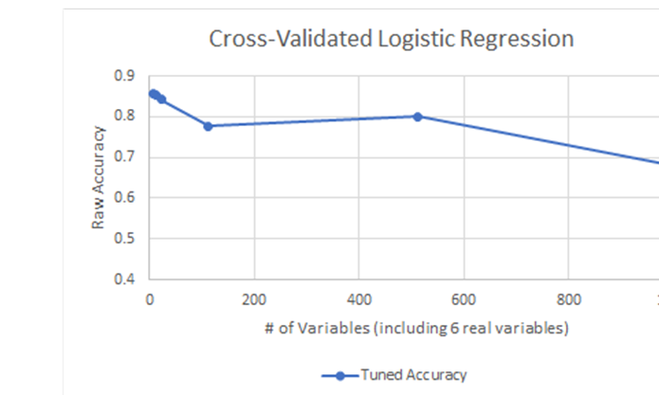
Logistic Regression Performance
Dependence on forward stepwise variable selection
Overall, strong performance considering only 310 observations

Slide 16
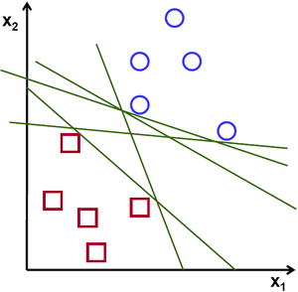
What are Support Vector Machines?
Support vectors
Decision boundary
Extends into n dimensions with the decision boundary in (n-1) dimensions
R package “e1071”
Notes:
separate the data by drawing support vectors from each observation to a specified area of division called a decision boundary
decision boundary that produces the best predictions for the training data is called the optimal margin classifier
Minimizes the number of incorrect predictions

Slide 17
Initial SVM
Train/Test Method:
Accuracy of 0.887
38 true positives, 5 false positives, 17 true negatives, 2 false negatives
Tune method of e1071:
Optimizes gamma and cost parameters of SVM
Tuned Train/Test Method:
Accuracy of 0.9032
38 true positives, 4 false positives, 18 true negatives, 2 false negatives
Notes:
- The gamma parameter changes how far the influence of each training observation reaches, or how much weight is given to each training observation.
- The cost parameter defines how much the model should avoid misclassification during its optimization.

Slide 18
Initial SVM with Cross-Validation
With Cross-Validation and Tuning:
Accuracy of 0.8484
186 true positives, 23 false positives, 77 true negatives, 24 false negatives
Did not perform as well as Train/Test Method, but is more indicative of the model’s actual performance

Slide 19
SVM with PRN and 10 RV
With Provided Random Noise, CV and Tuned:
Accuracy of 0.8290
184 true positives, 27 false positives, 73 true negatives, 26 false negatives
With 10 Random Variables, CV and Tuned:
Accuracy of 0.8129
181 true positives, 29 false positives, 71 true negatives, 29 false negatives

Slide 20
SVM with 100, 500, 1000 RV
With 100 Random Variables, CV and Tuned:
Accuracy of 0.6903
169 true positives, 55 false positives, 45 true negatives, 41 false negatives
With 500 Random Variables, CV and Tuned:
Accuracy of 0.6774 → ratio of abnormal to normal
210 true positives, 100 false negatives
With 1000 Random Variables, CV and Tuned:
Accuracy of 0.6903 → ratio of abnormal to normal
209 true positives, 95 false positives, 5 true negatives, 1 false positive
Notes:
Interesting the model with 1000 random variables performs better than 500. This is likely due to the randomness involved in each iteration of training the model as seen in the histogram of the accuracy scores for the Logistic Regression model with 100 random variables. They are essentially the exact same models.

Slide 21
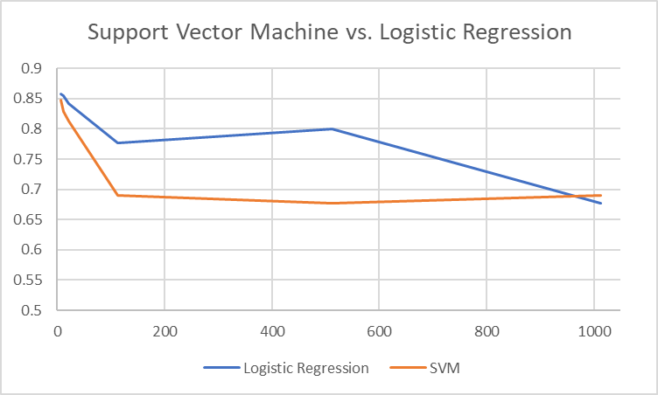
Performance of SVM’s
Performed very well with just the real variables
Only model to reach 90% accuracy – but without cross-validation
Performed worse than Logistic Regression when any random variables are included
Weaker tuning process and variable selection method

Slide 22
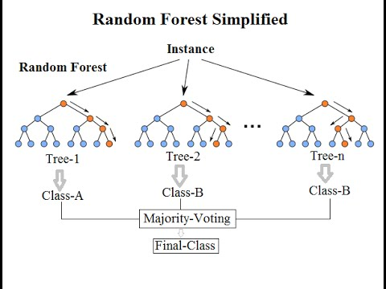
What are Random Forests?
Trains many decision trees
Decision trees look for divisions in the data that are defined by a predictor variable, which maximize the difference in the response variable between groups
Each tree has different subset of predictors
Majority-Voting
Reduce Overfitting
TuneRF() – mtry
Notes:
Mtry parameter tells the model how many random variables to select for each decision tree

Slide 23
Initial Random Forest
Train/Test Method:
Accuracy of 0.8065
38 true positives, 2 false positives, 12 true negatives,10 false negatives
Train/Test with Tuning:
Accuracy of 0.8306
39 true positives, 1 false positive, 13 true negatives, 9 false negatives

Slide 24
Initial Random Forest
Cross-Validation with Tuning:
Accuracy of 0.8419
187 true positives, 23 false positives, 74 true negatives, 26 false negatives

Slide 25
Random Forest with PRV & 10 RV
With Cross-Validation and Tuning
Provided Random Noise:
Accuracy of 0.8161
188 true positives, 22 false positives, 65 true negatives, 35 false negatives
10 Random Variables:
Accuracy of 0.8387
185 true positives, 25 false positives, 75 true negatives, 25 false negatives

Slide 26
Random Forest 100, 500, 1000 RV
With Cross-Validation and Tuning
100 Random Variables:
Accuracy of 0.7548
192 true positives, 18 false positives, 42 true negatives, 58 false negatives
500 Random Variables:
Accuracy of 0.7903
182 true positives, 28 false positives, 63 true negatives, 37 false negatives
1000 Random Variables:
Accuracy of 0.6774 with 210 true positives, 100 false positives

Slide 27
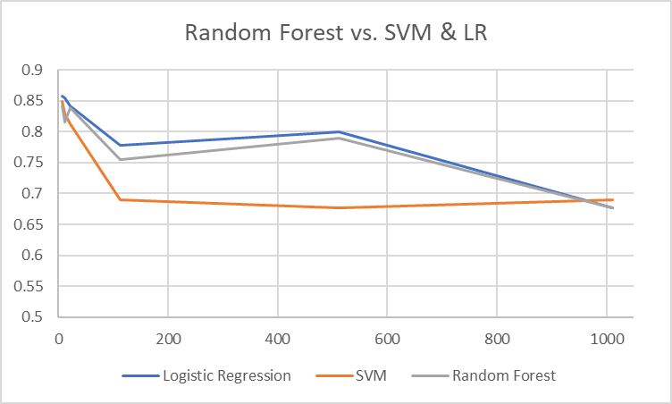
Performance of Random Forest
Strong performance under 500 variables
Very similar performance to Logistic Regression

Slide 28
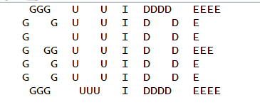
G.U.I.D.E
Professor Wei-Yin Loh at the University of Wisconsin, Madison
“Generalized, Unbiased, Interaction Detection and Estimation”
Modified decision tree method
Smarter splitting algorithms
Built in cross-validation
All default options

Slide 29
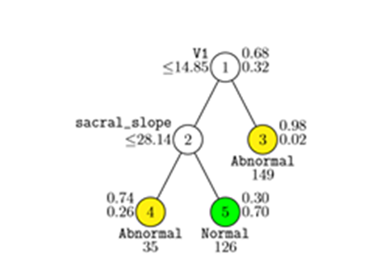
Initial Model – Including PRV
Accuracy of 0.839
172 true positives, 12 false positives, 88 true negatives, 38 false negatives
LaTex code to produce tree
Tree interpretation
V1 = degree_spondylolisthesis
Notes:
V1 is degree_spondylolisthesis and if its value is less than or equal to 14.85 and sacral_slope is less than 28.14, then the observation is classified as abnormal, if degree_spondylolisthesis is less than or equal to 14.85 and sacral_slope is greater than 28.14 then the observation is classified as normal, and if degree_spondylolisthesis is greater than 14.85, then the observation is classified as abnormal

Slide 30
G.U.I.D.E 10 and 100 RV
With 10 Random Variables: Exact same as previous model
Accuracy of 0.839
172 true positives, 12 false positives, 88 true negatives, 38 false negatives
With 100 Random Variables: Exact same as previous model
Accuracy of 0.839
172 true positives, 12 false positives, 88 true negatives, 38 false negatives

Slide 31
G.U.I.D.E 500 & 1000 RV
With 500 Random Variables:
Accuracy of 0.865
199 true positives, 31 false positives, 69 true negatives, 11 false negatives
With 1000 Random Variables: Exact same as first 3 models
Accuracy of 0.839
172 true positives, 12 false positives, 88 true negatives, 38 false negatives

Slide 32
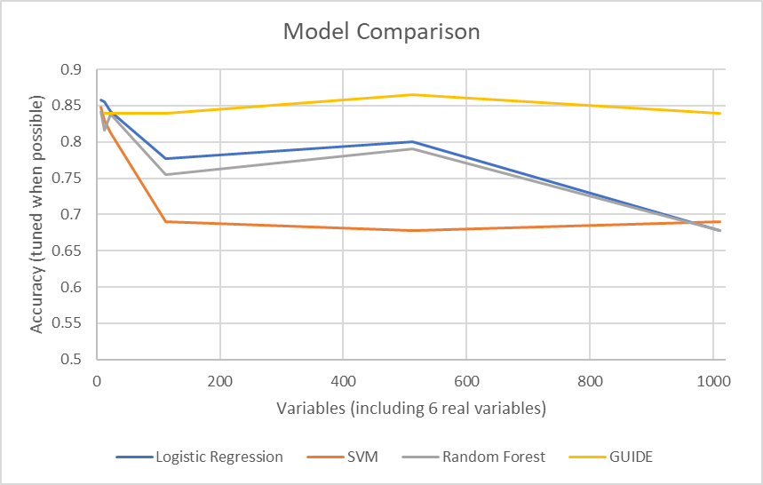
Overall Performance Comparison
G.U.I.D.E outperformed
Superior variable selection process
Random Forest and Logistic Regression
SVM performed poorly after the addition of 100 RV’s
All models could be improved

Slide 33
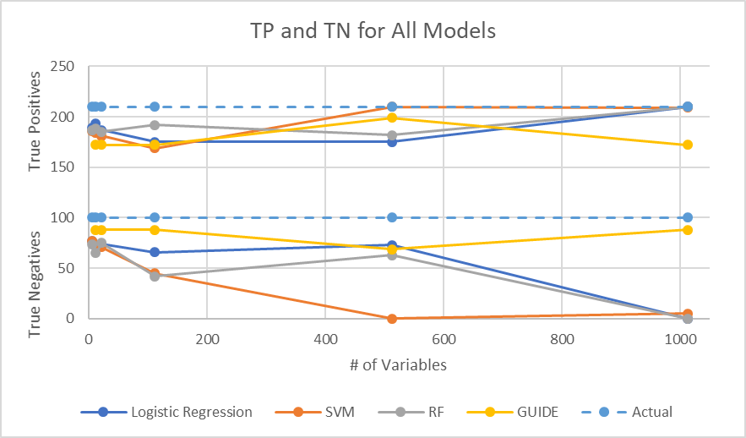
Model Comparison
GUIDE has the highest True Negatives
High True Positives isn’t necessarily good because of the models that predicted all Abnormal

Slide 34
Thanks!

Slide 35
The following are additional slides

Slide 36
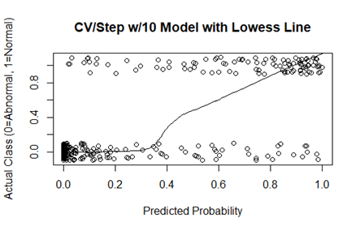
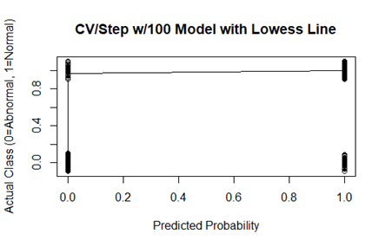
Logistic Regression Performance
Classification vs Predicted Probability of Normal
10 added random variables vs 100 added random variables

Slide 37
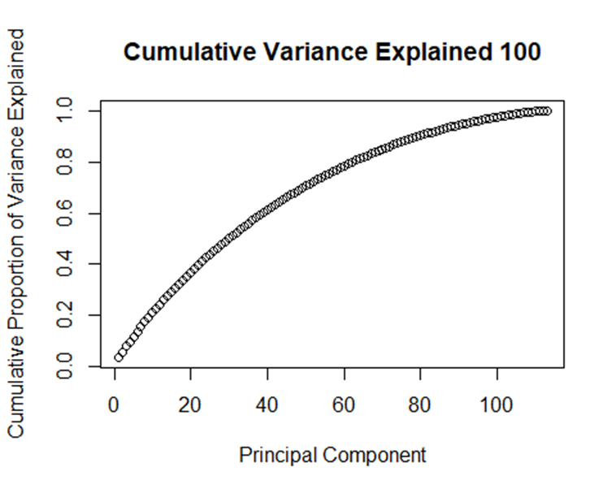
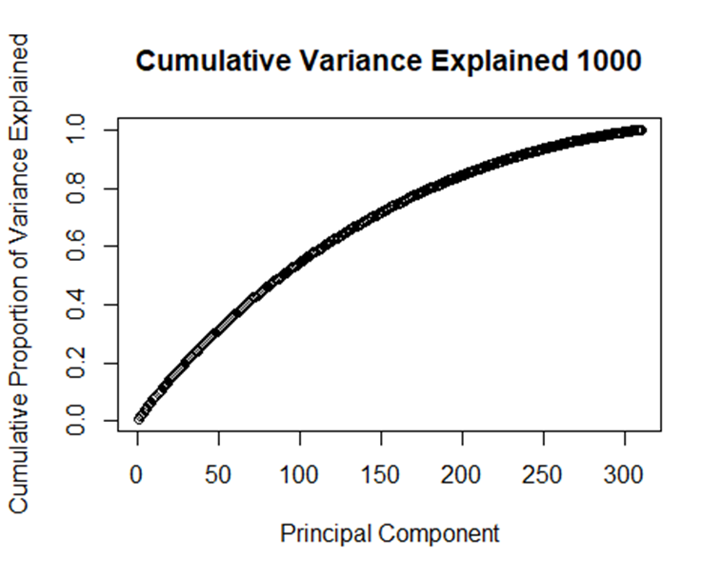
Principal Component Analysis

